Slide 1

ZetaPrints
A solution for Web-to-Print
http://www.Zetaprints.com
Presented By Hema Pasupuleti

Slide 2
Introduction
ZetaPrints offer web-to-print software for template-based online print ordering to suit a small shop or a large corporate.
A simple and easy ordering process gives you a print-ready PDF with all the user text, images, effects and transformations created on the fly.
A simple, powerful and fully hosted site.

Slide 3
Services
They offer different packages to suit different needs like Core, E-Commerce and Enterprise.
Core package could be the best option for
Copy Express to start with.

Slide 4
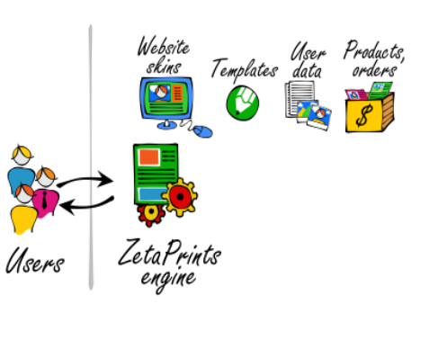
How it works

Slide 5
Strengths
Ease of use: easy
Time to launch: minutes
Customization: limited but can change the site appearance and Home page layout etc.,
Total cost of ownership: minimal
Technical expertise: minimal
Features: full set that includes :

Slide 6
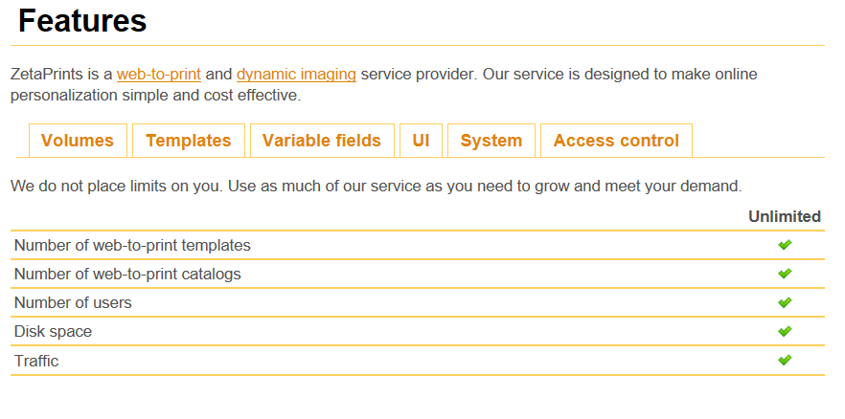
Full set features
Volumes

Slide 7
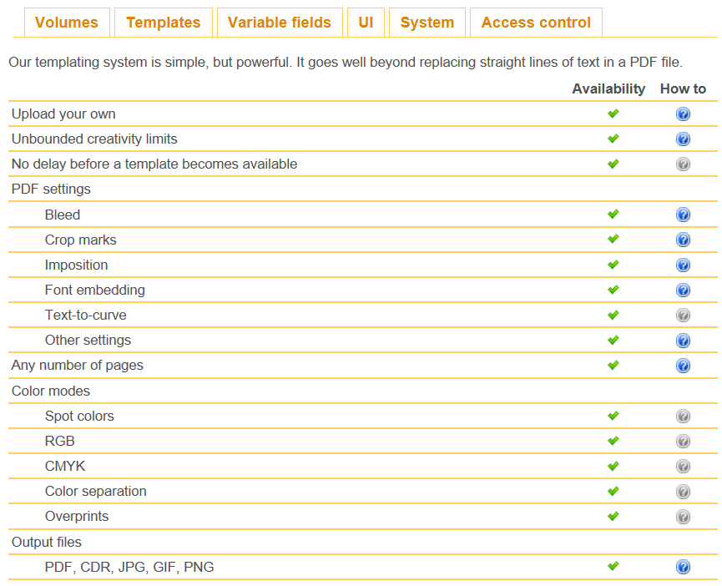
Templates

Slide 8
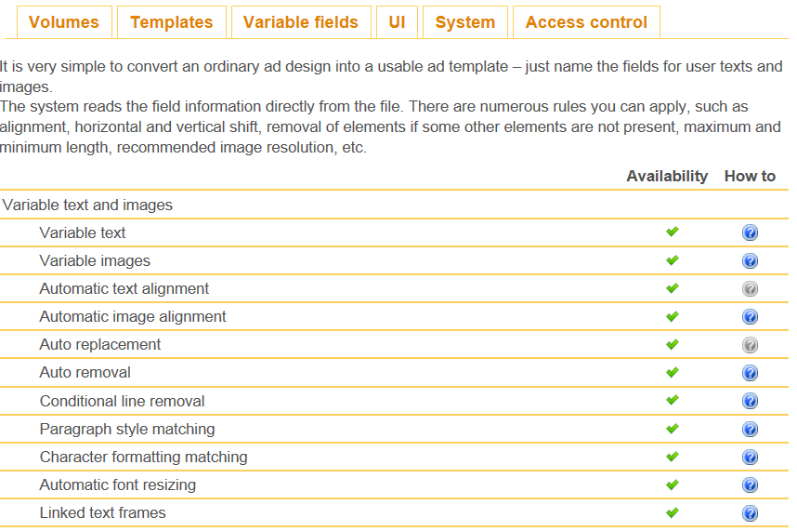
Variable Fields

Slide 9
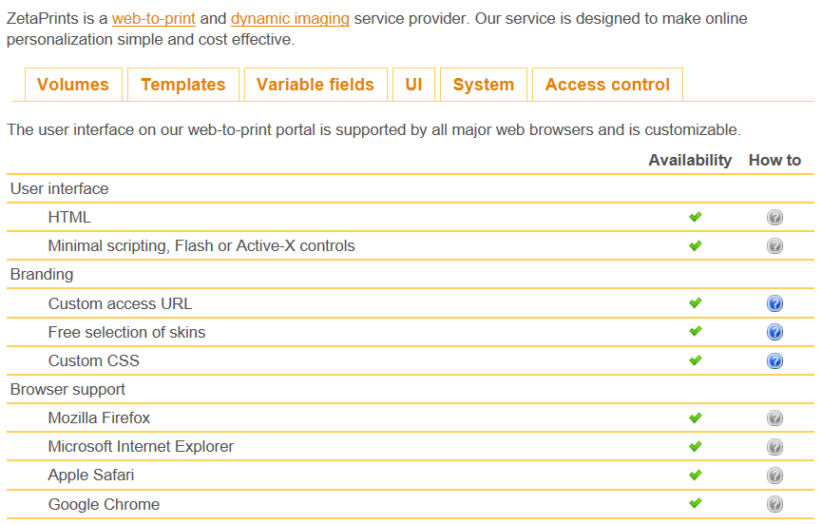
User Interface

Slide 10
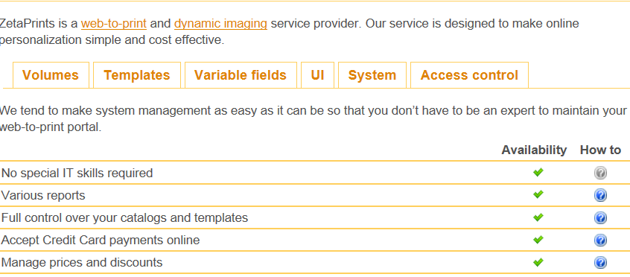
System

Slide 11
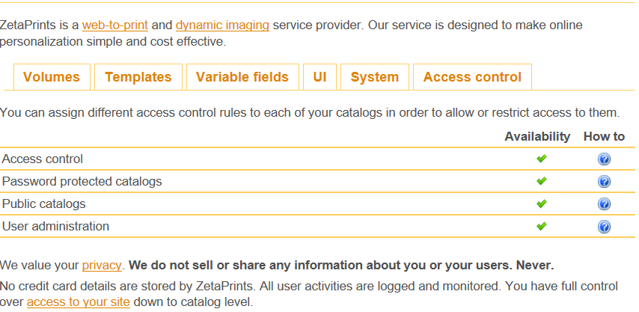
Access control

Slide 12
Weaknesses
extensive front-end customization
changes to the process / workflow
(advised to have E-Commerce package)
If intended to sell a mix with other non-customizable products
Planning to host a web-to-print engine on your own server (other Enterprise package might be suitable).

Slide 13
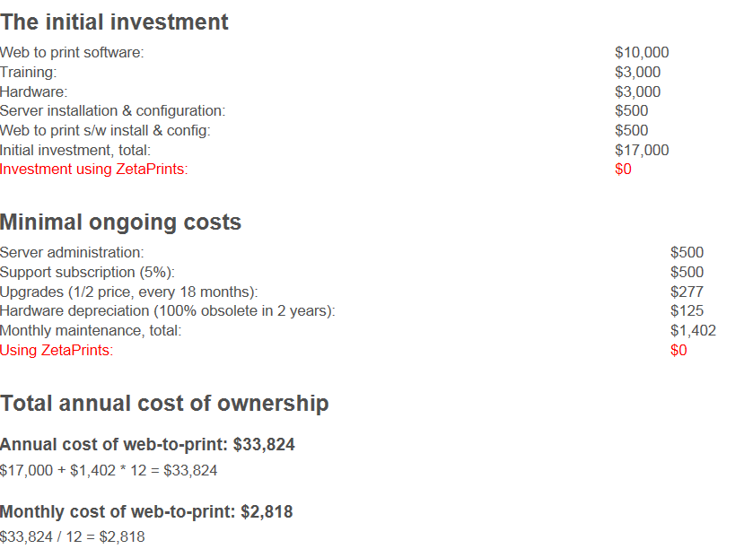
Cost
Cost of ownership

Slide 14
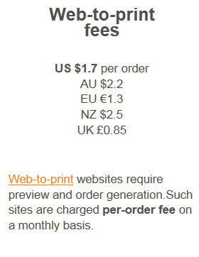
Cost
As you go and Pay price

Slide 15
End of Presentation

